Slide 1
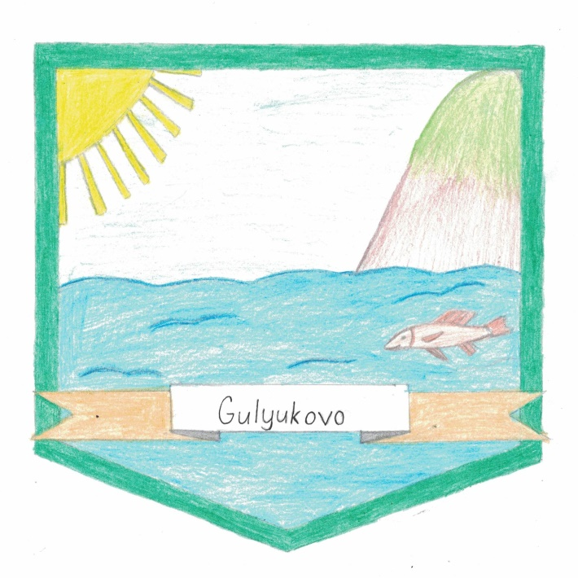


Межрегиональная научно
-практическая конференция «Иностранный язык –диалог культур»
The symbol of Gulyukovo
Сайфиева Айзиля
Муниципальное бюджетное учреждение
дополнительного образования
«Дом детского творчества»
г. Мензелинска Республики Татарстан

Slide 2


Оглавление:
1.Введение:
цель;
задачи;
предмет исследования;
актуальность;
план действий,;
методы исследования
2. Основная часть:
Связь с историей Гулюково;
Создание символа Гулюково;
Опрос жителей села Гулюково, анализ опроса;
3.Заключение.
Список литературы.
Приложения.

Slide 3
Цель проекта: изучение истории села Гулюково; привитие интереса к истории малой родины
Задачи:
1) привить интерес к истории родного села среди своих сверстников ;
2)пополнить историю села новой страницей;
3)привлечь внимание туристов

Slide 4
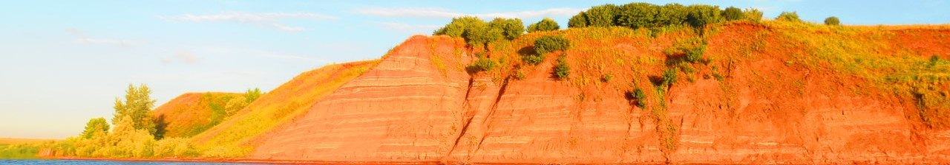
Актуальность
Предмет исследования:
материалы по истории села Гулюково
Константин Дмитриевич Ушинский:
«Поля Родины, ее язык, ее предания и жизнь никогда не теряют непостижимой власти над сердцем человека".

Slide 5
- изучение культуры, быта населения,
- экскурсии к памятным местам;
- беседы и встречи с интересными людьми села.
Гипотеза: чем больше мы узнаем историю родного края, тем больше не перестаем удивляться его величию .
План действий:

Slide 6
Методы исследования: - изучение истории села Гулюково;
- метод опроса;
- поиск полезной информации в Интернете;
- анализ;
- обобщение

Slide 7
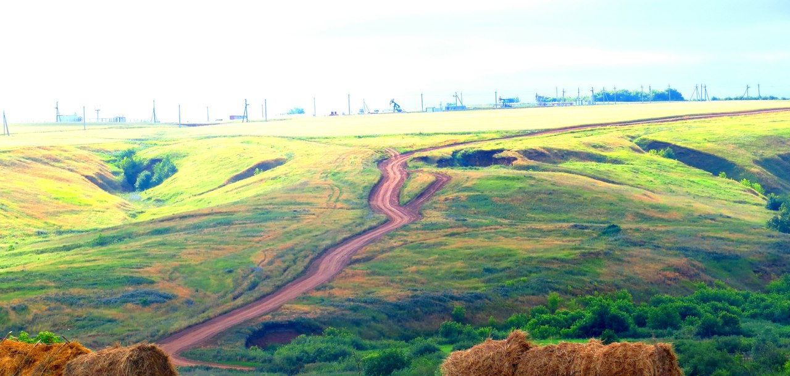
Every man has his own Motherland. It`s the place, where a man was born. Maybe this place is usual and uninteresting for other people, but for you it is the dearest place in the world. There is no place like home.
No need to roam the world in the search of the most beautiful place. You should turn around. It`s your native home place, the land, where you were born, whose beauty you imbibed with your mother`s milk. One of such place is my native village

Slide 8
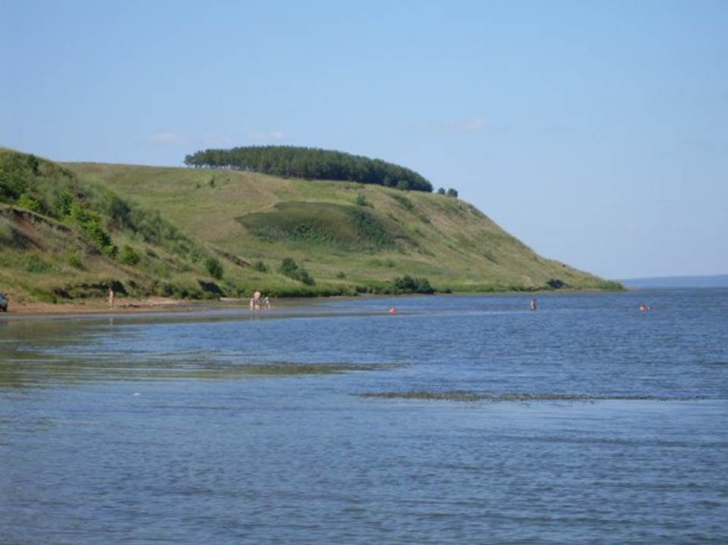
The history of my village began in the 17th century, when
the people began to settle on the left bank of the river Ik

Slide 9
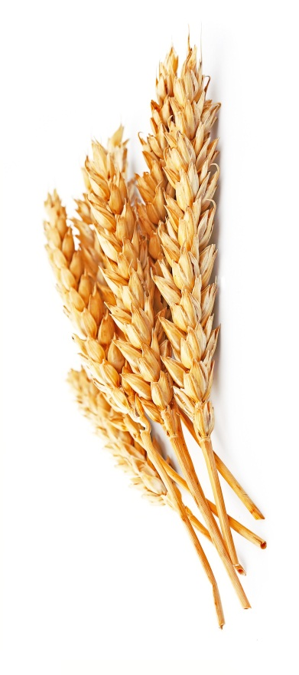
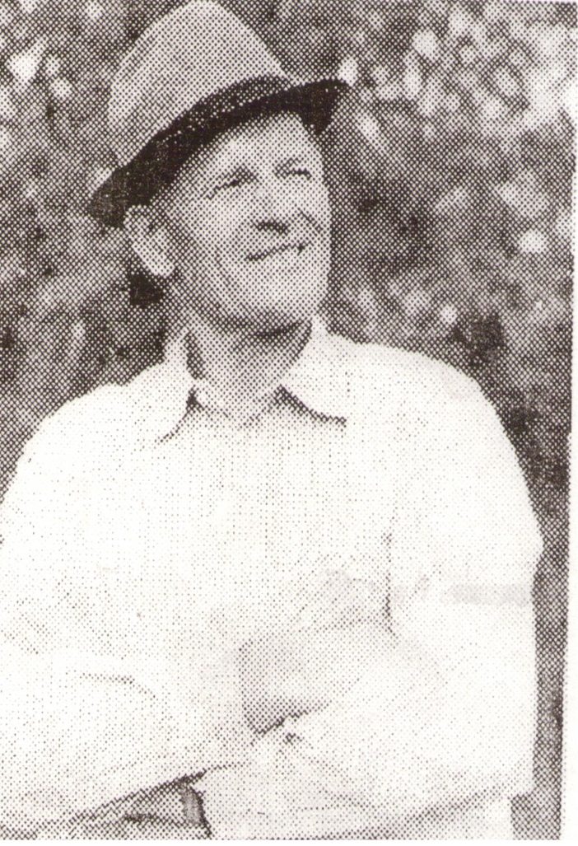
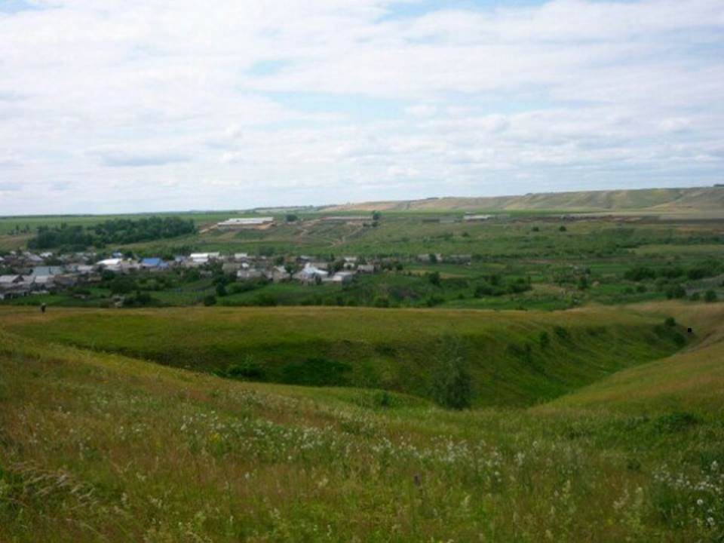
The famous person of our region Rafckat Zakirov wrote many poems about the
beautiful nature
of the countryside

Slide 10
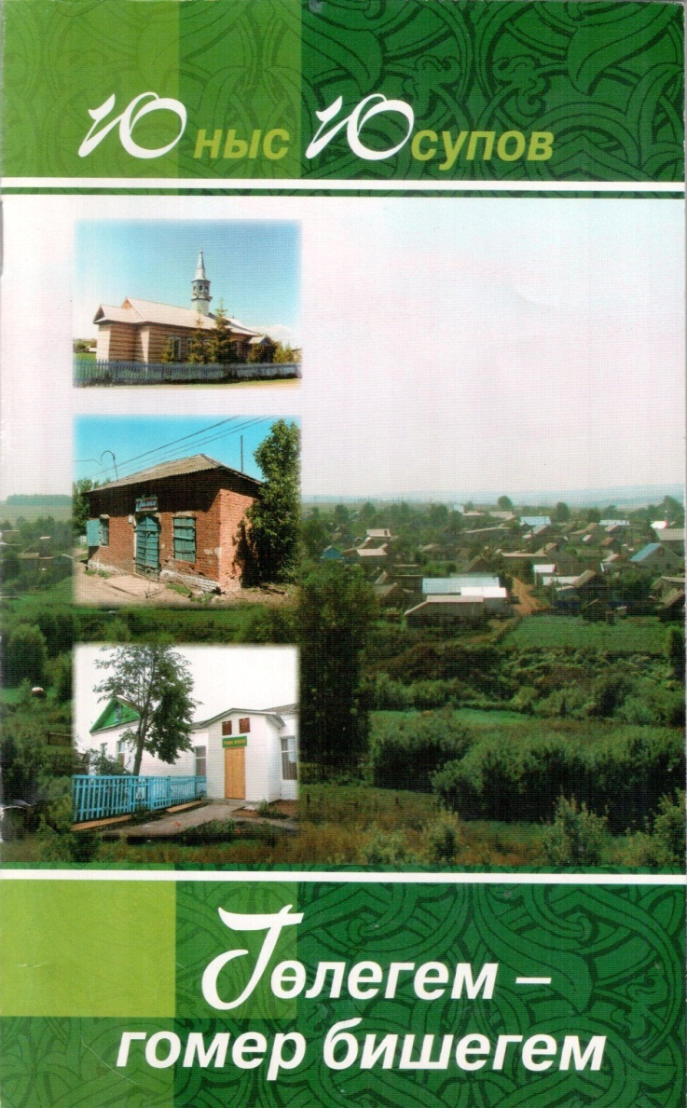

We have some books about our native village Gulyukovo in our school library

Slide 11
Interview with people of Gulyukovo
about the symbol
What do you want to see on the symbol of your village?
.
I want to see the sun, because it means warm relationships between the people and the life on the Earth.
I want to see the Ik, because the history of my village began there.
I want to see fish in the crystal clear water of Ik.
I want to see hills of Igat, because our village is situated in a very picturesque place.

Slide 12
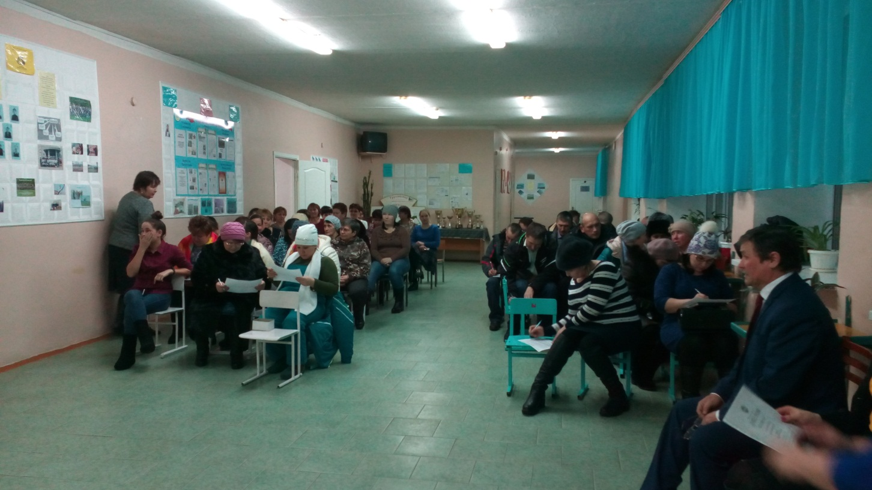
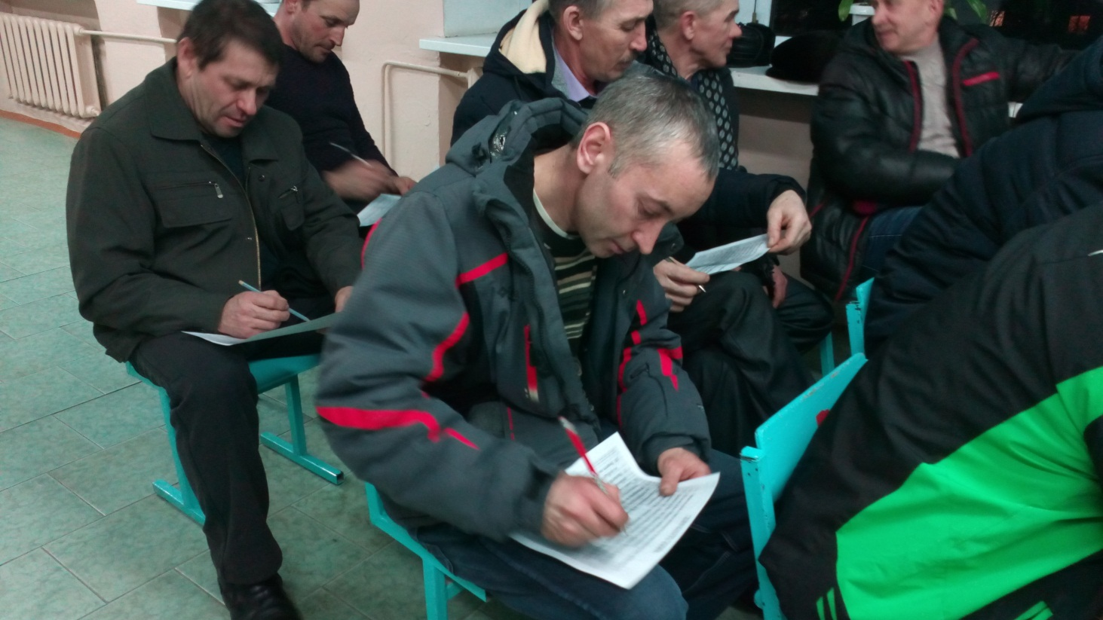

Slide 13
The results of the interview

Slide 14


Slide 15

The SUN
The sun is very important for all the living things.
The sun is the largest star. It produces light and heat energy to all people on the Earth.

Slide 16
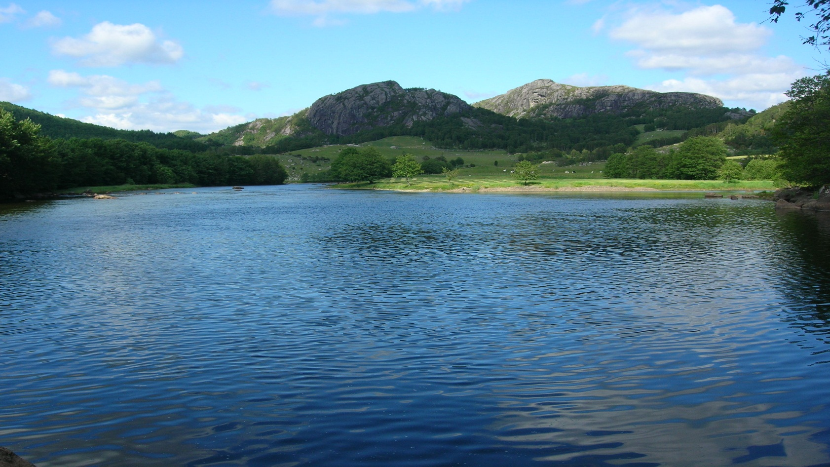
The RIVER
Ik River (Russian: Ик; Tatar: Ык, Latin Iq; Bashkir: Ыҡ) is a river in Russia that flows north to the Kama River.
The people from other places come to Ik to spend their weekends, they put up the tents, have a rest, sunbathe and they are fond of fishing.

Slide 17
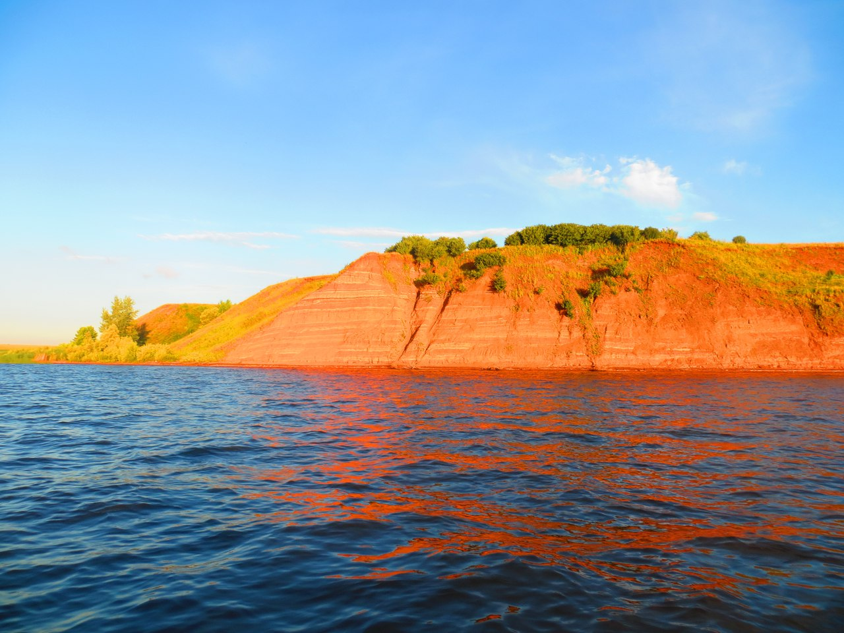
Hills of IGAT
My village is famous for its wonderful nature and the river full of fish. There are Igat hills not far from Gulyukovo. It makes our nature very beautiful and nice.

Slide 18
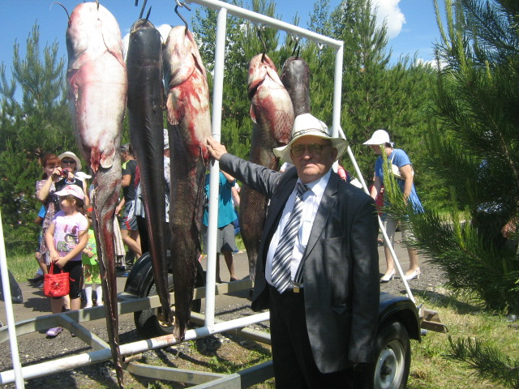
Fish
Fishing is one of the views of business and employment of the villagers. 3 years ago Zakirov caught fish that weighed more than 30 kg.

Slide 19

Conclusion
Working on this project we have had an opportunity to practice and learnt English language and the same time we gained a lot of information and developed various important skills. This project helped us to improve our English. The material in the project provides useful translation activities.
We want that this project would be read by people all over the world. We think our village is famous not only for its beauty but also for its people. If you come to my village you'll find people there warm and friendly. Most people are hard-working and optimistic.
So our native village is a nice place to live in. The life there is quiet and peaceful.
There is no place like home.
Welcome to our village!

Slide 20
Used resources:
Башаклар нуры. Р.Закиров.Ислам нуры, Яр Чаллы, 2005ел.
Голегем-гомер бишегем. Ю.Юсупов. «Минзэлэ» китапханэсе, 2009 ел.
Фото из личного архива Ф.Баттала.
Фотографии из семейного альбома Закировых.
https://en.wikipedia.org/wiki/Ik_River
http://www.aquaexpert.ru/enc/reservoir/ik/
https://translate.academic.ru/
https://www.native-english.ru/topics/

Slide 21
